Slide 1
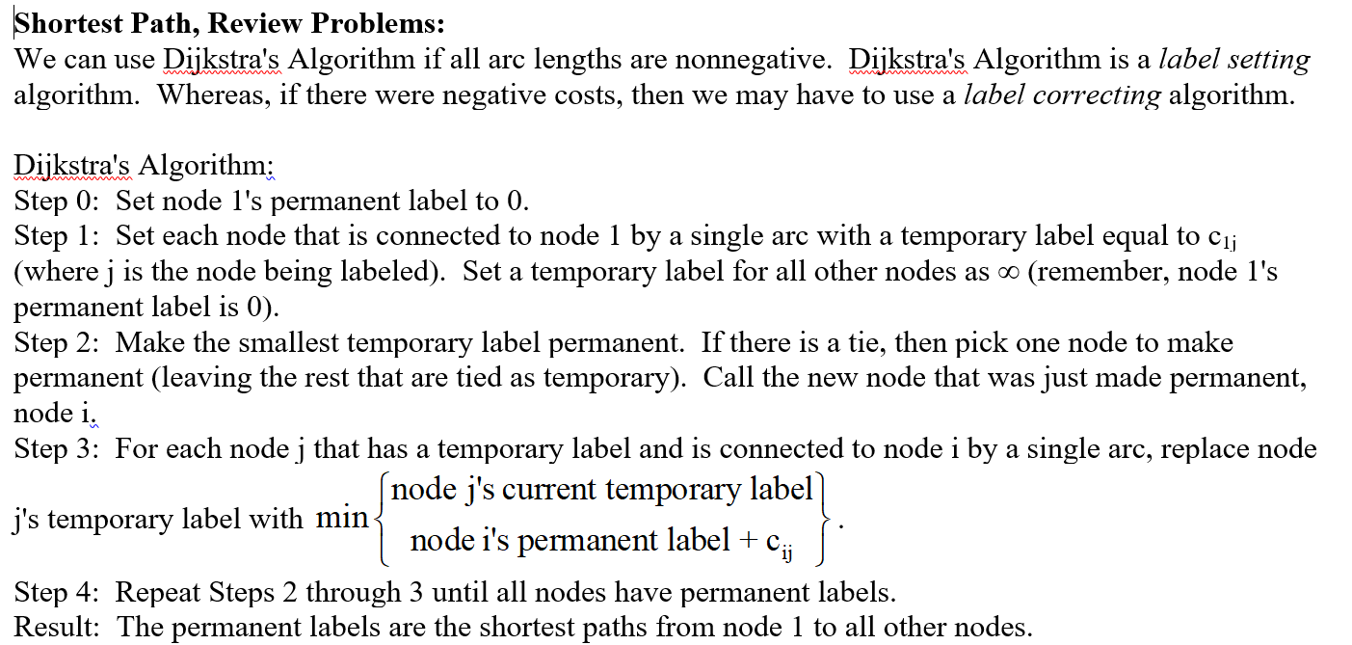
T=2
P=2
2
2
5
P=0
1
1
4
T=infinity, 7, 6
P = 6
4
3
3
Shortest Path
1->2->3->4; distance = 6
T=4, 3
P=3

Slide 2
T=3
P=3
T=infinity, 4
P=4
T=infinity, 9
1
3
2
1
3
5
4
P=0
1
-3
5
T=infinity, 1
P=1

Slide 3
t=6
P=6
6
2
-3
P=0
1
4
4
t=infinity, 4
P = 4
2
3
2
t=2
P=2

Slide 4
t=2
P=2
t=infinity, 4, 3
P=3
1->3->5->6
1->3->5->4->6
Distance of 9
2
2
5
4
6
P=0
1
3
3
1
6
t=infinity, 9, 9
P=9
1
3
5
7
1
t=1
P=1
t=infinity, 2
P=2

Slide 5
T=208
P=208
T=258
P=258
T=355
P=355
T=537
P=537
T=841,
(208+557) = 765,
(258+395) =
653
P=653
Buy machine at beginning of year 1, beginning of year 3, and a total cost of ownership of $653,000.
278
557
395
258
537
1
208
228
248
288
338
P=0
2
3
4
5
6
355
841
375
298
338

